Slide 1
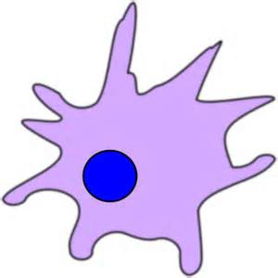
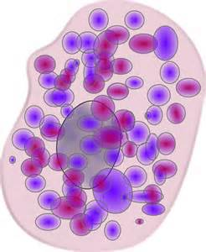
5th Grade Science Chp. 1
Simple Living Things

Slide 2
Activities of Life
All organisms either one cell or many celled perform the activities of life.

Slide 3
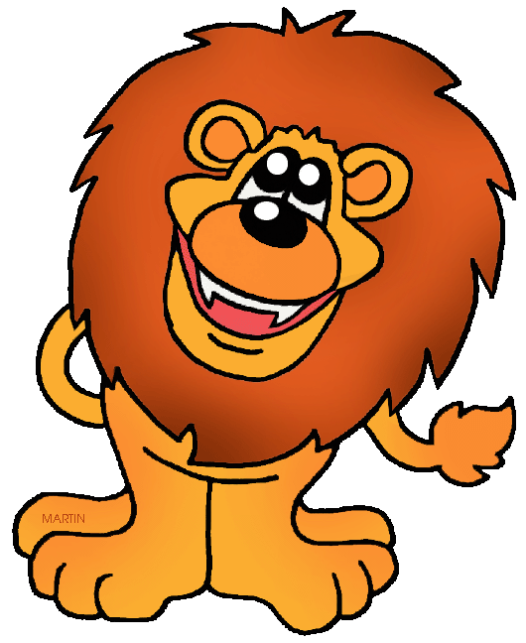
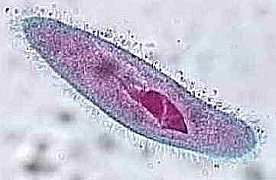
Activities of Life
Reproduce
Uses food for energy
Move
Grow
Respiration
Gets rid of wastes

Slide 4
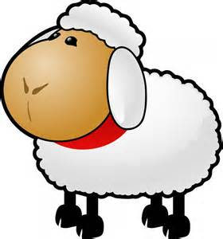
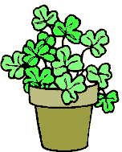
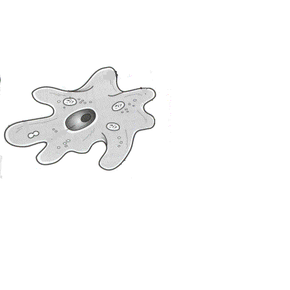
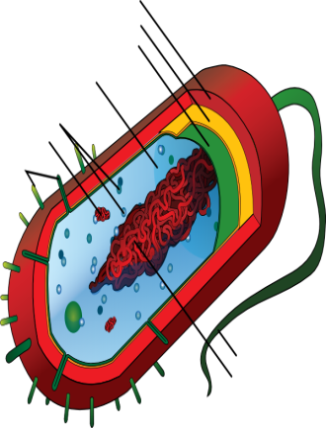
Kingdoms of Living Things
Animals – multi-celled
Plants - multi-celled
Fungi – most many celled
Protists – one celled
Monerans – Bacteria – one celled

Slide 5
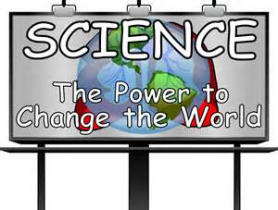
All People Feed Pink Monkeys
Animals
Plants
Fungi
Protists
Monerans

Slide 6
Key Words Lesson 1
Cell – the basic part of all living things.
Organism – any single living thing.
Kingdoms- one of the five large groups of all living things.

Slide 7
How are many celled organisms different than one-celled organisms?

Slide 8
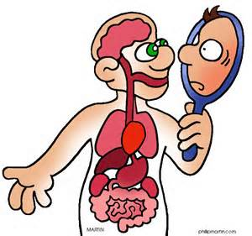
Answer
A one-celled organism can perform all the functions of life in that one cell.
A multi-celled organisms needs many cells to perform the various functions of life.

Slide 9
Vocabulary – Lesson 2
Protists – one celled organism that can be plant like or animal like.
Cell Membrane- a structure that surrounds and protects a cell.
Cytoplasm – the jellylike substance that surrounds the nucleus of the cell.
Cell Wall – a stiff structure outside the cell membrane of plant cells.
Nucleus – the control center of the cell.

Slide 10
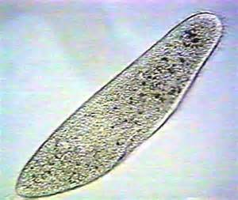
Protists
One-cell organism
Some are animal like, some plant like.
Most live in water or moist places.

Slide 11
What makes Protists Animal like?

Slide 12
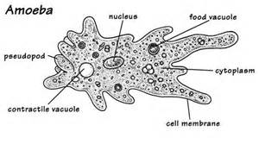
What makes Protists Animal like?
They eat other organisms.
Do not make their own food.
They move.

Slide 13
What makes Protists Plant like?

Slide 14
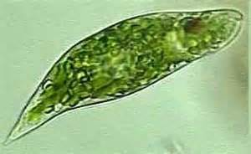
What makes protists plant like?
Make their own food through the process of photosynthesis.
Do not move from place to place.
Contain chlorophyll.

Slide 15
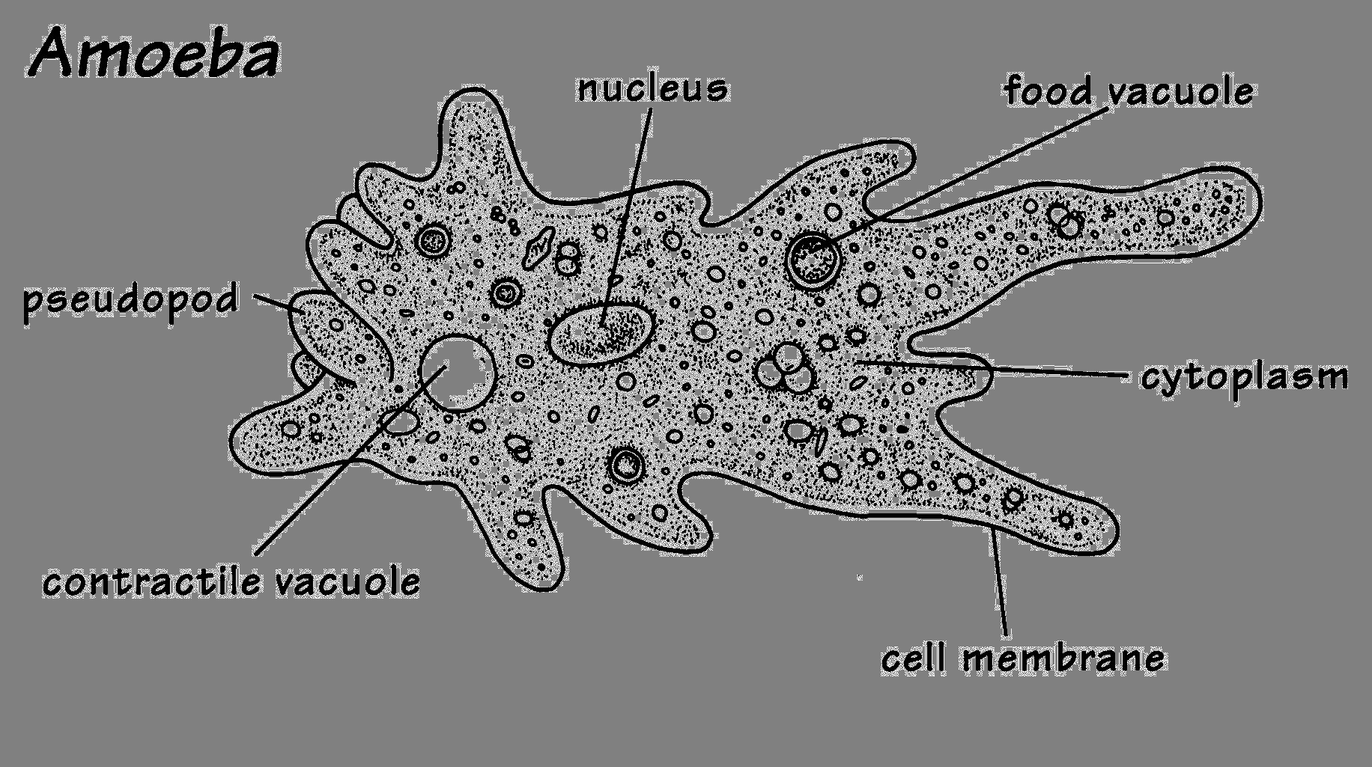
Ameba – animal like protist
Cell membrane
Nucleus
Cytoplasm .
Pseudopods or false feet .
One-celled .
Eats algae and other one-celled organisms.
Found in Fresh Water like ponds.
Microscopic.

Slide 16
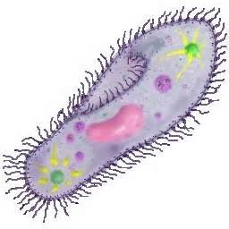
Paramecium – Animal like Protist
One-celled organism.
Microscopic smaller than an ameba.
Found in fresh water like pond water.
Cilia – hair like projections that are a means of movement.
Eats bacteria or other one-celled animals.

Slide 17
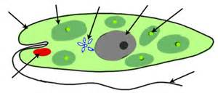
Euglena – Animal like Protist
One-celled animal like protists.
Eat algae.
Found in fresh water.
Flagellum – Whip-like structure.

Slide 18
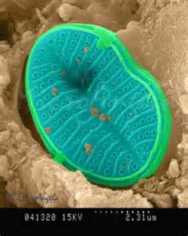
Diatom – Plant like Protist.
Contains chlorophyll in chloroplasts.
Cell wall
Diatoms are found in the oceans.
When they die their outer hard structures fall to the bottom of the ocean.
These remains are used in toothpaste, scouring powder, pest dusting powder.

Slide 19
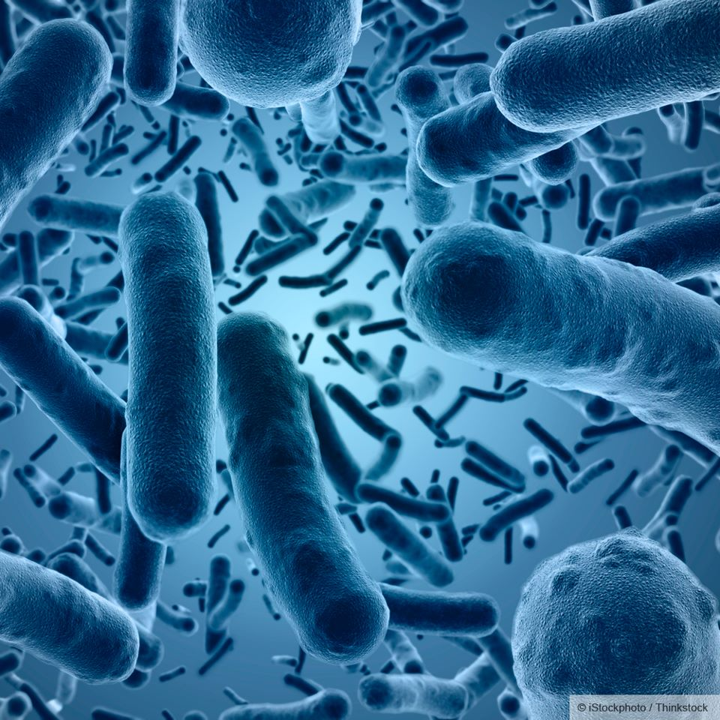
Monerans, Bacteria & Viruses
Monerans –
A one-celled organism that does not have a nucleus.
Bacteria –
Another name for monerans.
Viruses –
A thing that seems to be alive but not made of cells.

Slide 20
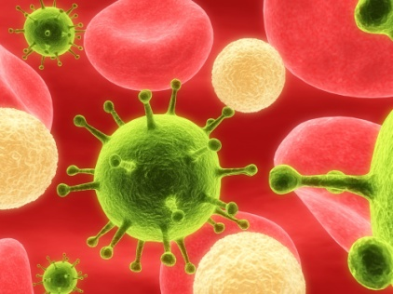
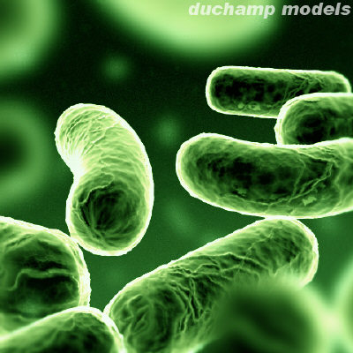
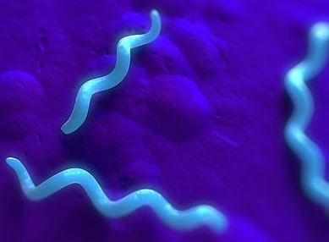
Types of Bacteria
Rod Shaped
Round Shaped
Spiral Shaped
How is bacteria classified?
By shape

Slide 21
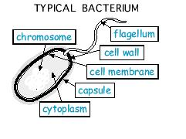
Moneran Characteristics
No nucleus
Some are plantlike
Very small – 500 bacteria can fit in one ameba.
Some contain chlorophyll
food.
Scavengers
One-celled
Cell wall
Cytoplasm with nuclear membrane.

Slide 22
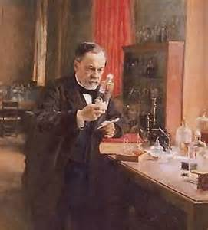
Louis Pasteur
French chemist and bacteriologist who developed the pasteurization process which removes bacteria from natural liquids like milk and juices.

Slide 23
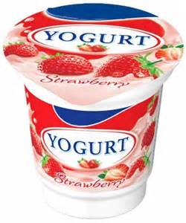
How Bacteria is Helpful
Used in food like yogurt
Break down food in intestines
Help to break down dead and decaying things.

Slide 24
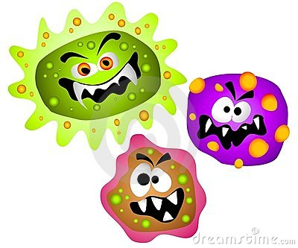
Harmful Effect of Bacteria
Causes illness and disease

Slide 25
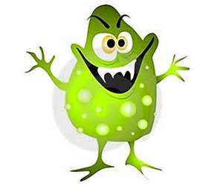
Diseases caused by Bacteria
Tetanus – can be prevented by vaccine
Food Poisoning
Lyme Disease – vaccine is available

Slide 26
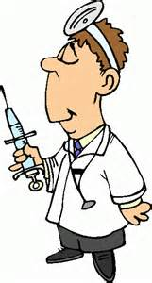
Sources of Food for Moneran
Some make their own food because they contain chlorophyll
Some absorb their food from what they are living on or in.

Slide 27
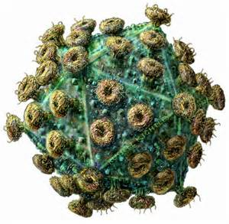
4 Traits of all Viruses
Not made of cells
Smaller than bacteria
Cause disease and illness
Reproduce inside of cells

Slide 28
Diseases caused by Viruses
Polio
German Measles
Flu
Cold
Aids
SARS

