Slide 1
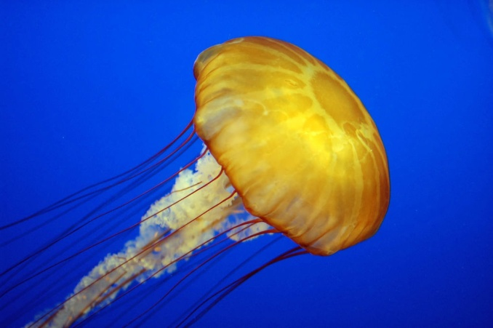
5th Grade Science Chp. 2
Invertebrates

Slide 2
Activities of Life
All living organisms are either one celled or many celled and perform the activities of life.

Slide 3
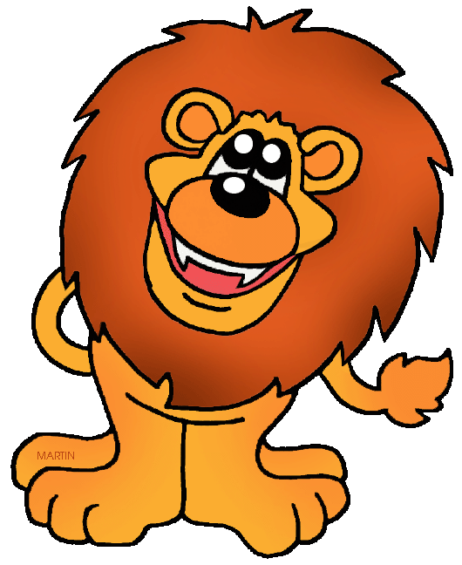
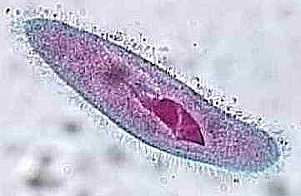
Activities of Life
Reproduce
Uses food for energy
Move
Grow
Respiration – exchange of gases
Gets rid of wastes
Made of cells

Slide 4
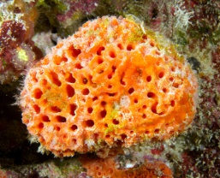
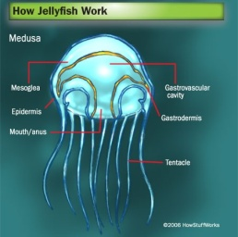
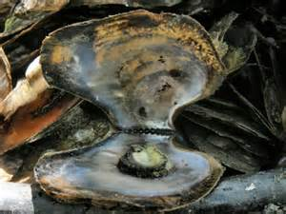
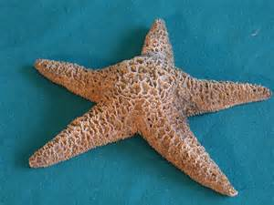
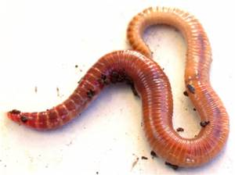
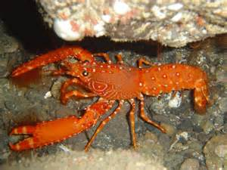
Five Groups of Invertebrates
Sponges
Stinging Cell Animals
Mollusks
Echinoderms
Worms
Arthropods

Slide 5
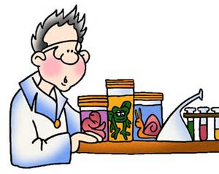
Invertebrates – an animal that has no backbone.
Vertebrates – an animal that has a backbone.

Slide 6
Lesson Review – Chp. 2 Less 1
Vertebrates and Invertebrates are different because vertebrates have backbones and invertebrates do not.
The percentage that includes animals without a backbone is 97%.
Scientists classify the many invertebrates into smaller groups because they are easier to study.

Slide 7
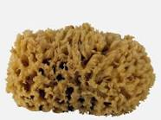
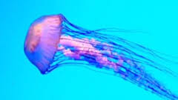
Chapter 2 Less 2 Vocab
Pore – a small hole or opening in a sponge.
Stinging Cells – a cell that contains a poisonous thread.
Tentacle- an arm-like part around the mouth of a stinging cell animal.

Slide 8
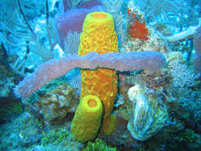
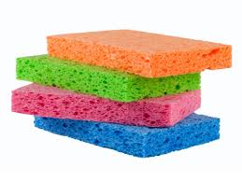
What are 8 traits common to all sponges?
Attached to surface
Pores
Filter water through pores
Live in water
Capture food with food trapping cells
Spicules
Regenerate
No backbone

Slide 9
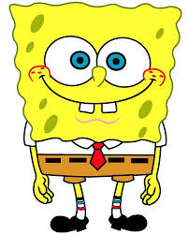
Vocabulary – Lesson 2
Regenerate– re-grow missing body parts.
Spicules – needlelike parts in a sponge that offer shape, support and protection.

Slide 10
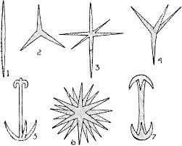
What are 4 things spicules do for a sponge?
Shape
Support
Protection
Classify

Slide 11
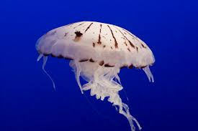
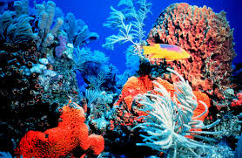
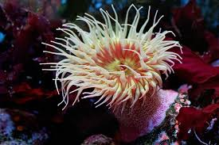
Stinging Cell Animals
Tentacles
Stinging Cells
Mouth – one body opening
Hollow Sac
Example: Jellyfish, Coral, Sea Anemone, Hydra
Jellyfish
Coral
Sea Anemone

Slide 12
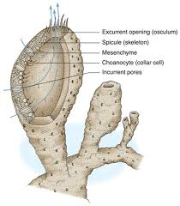
Sponge Diagram

Slide 14
Lesson Review Pg 67
Sponges are alike as they have pores, spicules, food trapping cells and are attached to hard surfaces.
Sponges get their food by filtering water that contains Plankton and other microspopic organisms.
All stinging cell animals have their stinging cells on their tentacles.

Slide 15
3 Groups of Worms –
Classified by body shape
Flatworm – flat body ex. Planaria, Tapeworm
Roundworm – round body ex. Hookworm
Segmented Worms – body in segments ex. Earthworm, Leech

Slide 16
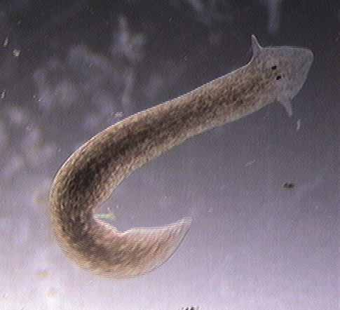
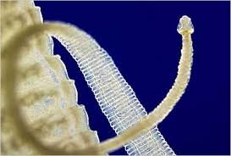
Characteristics of Flatworm
Flat body.
One body opening.
Most simple worm.
Most are parasites.
Planaria
Tapeworm

Slide 17
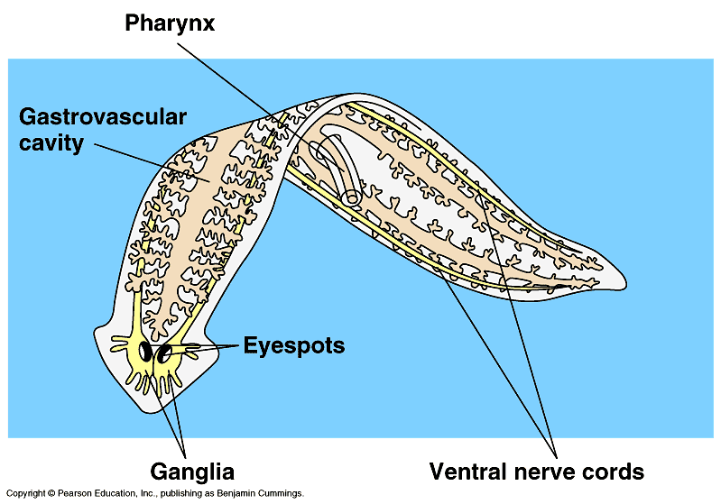
Planaria – Flatworm
Lives in fresh water
Scavenger
Regenerates
Very small – approx. 1 inch in size.

Slide 18
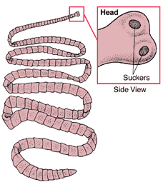
Tapeworm – Flatworm
Lives in intestines of host
Parasite

Slide 19
Parasite - an animal that lives on or in another living thing and harms that thing.
Scavenger – an animal that feeds off of dead and decaying organisms.

Slide 20
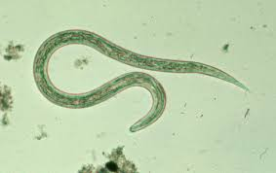
Characteristics of Roundworm
Body shape is round.
Some are parasites.
Two body openings.
Cause disease and illness.
Hookworm

Slide 21
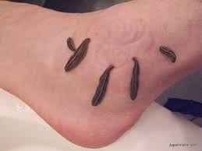
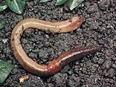
Characteristics of Segmented Worm
Body in segments.
Some are parasites like the leech.
Some are scavengers like the Earthworm.
Leeches
Earthworm

Slide 22
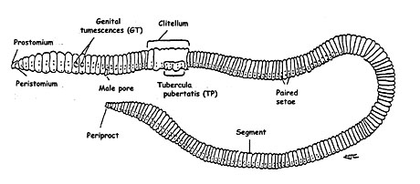
Earthworms – Segmented Worms
Scavengers
Live in soil
Digestive System
Circulatory System
Breathe through skin

Slide 23
Segmented Worms
Coelom – fluid filled sac that protects the internal organs.
Setae – hair like structures on the segments of the worm that help it to move.
Crop – Part of the segmented worm’s digestive system where food is stored.
Gizzard – Part of the segmented worm’s digestive system where food is broken down.

Slide 24
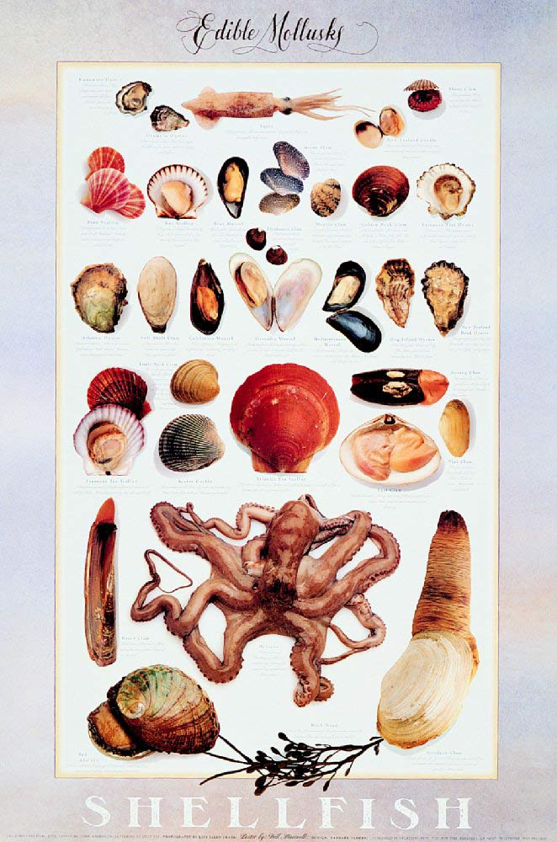
Vocabulary – lesson 4
Mollusk – an invertebrate that has a soft body.
Mantle – a fleshy covering that protects the organs of a mollusk.

Slide 25
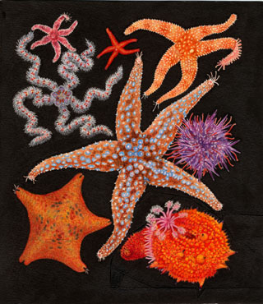
Vocabulary – lesson 4
Echinoderms – a spiny-skinned invertebrates that lives in the ocean.
Tube Foot – a hollow structure with a sucker at the end.

Slide 26
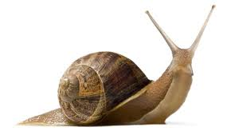
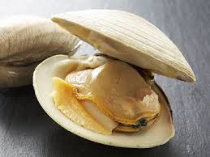
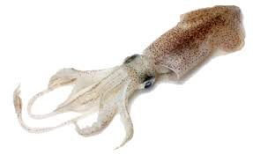
Three Types of Mollusks
Univalve – one shell, example snail
Bivalve – two shells with a hinge, example clam
Cephalopod – No shell on the outside, appears inside, example squid

Slide 27
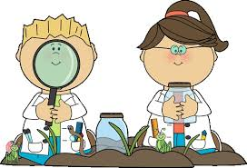
5 Common Traits of Mollusks
Most have a shell
Three part body – body mass, head, foot
Mantle
Soft-bodied
Most live in water

Slide 28
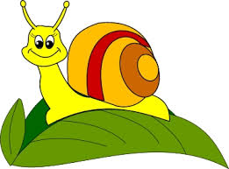
Snail - Example of a Univalve
One shell
Three part body
Head, Foot and Body Mass
Sense organs located on the head and antennas

Slide 29
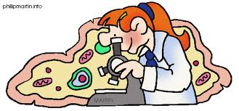
Traits of Echinoderms
All live in water
Tube feet used for eating and moving
Spiny Skin

Slide 30
Starfish – Example of Echinoderm
Hard body
Spiny Skin
Regenerate
Tube Feet
Eats Clams and Oysters
Lives in the Ocean

Slide 31
Arthropods – lesson 5 Vocabulary
Arthropod – an animal with jointed legs, a segmented body and hard outer covering.
Exoskeleton – Hard outer covering of Arthropods.
Molt – to shed the outer body covering.
Thorax – middle part of an insect’s body where legs or wings (if any) are located.
Abdomen- rear part of insect’s body where internal organs are located.

Slide 32
Arthropods
Crustaceans – ex. Lobster, Shrimp
Arachnids - ex. Spider, tick
Insects – ex. Beetles, Fly, Bee
Chilopod – ex. Centipede
Diplopod - ex. Millipede

Slide 33
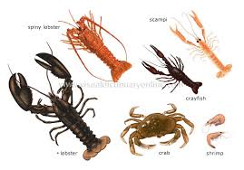
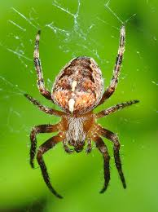
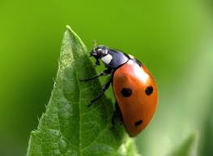
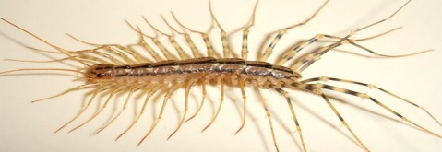
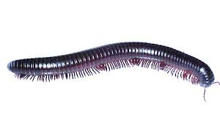
5 Groups of Arthropods
Cool Crustaceans
Apes Arachnids
In Insects
Canada Chilopods
Dance Diplopods

Slide 34
Arthropods – Traits
Exoskeleton
Jointed Legs
Segmented body
Most Molt
Some have antennas

Slide 35
How are Arthropods Classified?
Body sections or segments
Number of Legs

Slide 36
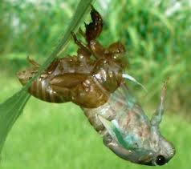
3 Functions of an Exoskeleton
Keeps water inside the body
Protects the body
Process of molting

Slide 37
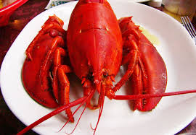
Crustaceans – ex. Lobsters
Two body sections
Two pairs of antennas
3 pairs of legs
Live in water

Slide 38
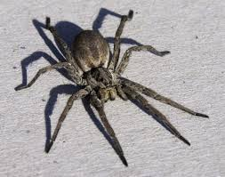
Arachnid – ex. Spider
Two body sections
No antennas
4 pairs of legs
Some are parasitic
Some are poisonous

Slide 39
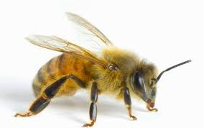
Insect – ex. Bee
Three body sections
Head, Thorax, Abdomen
1 pr antennas
3 pairs of legs

Slide 40
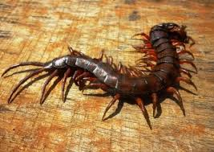
Chilopod – ex. Centipede
More than 3 body sections
1 pr antennas
1 pr of legs per body section
Carnivore – eats other insects

Slide 41
Diplopod – ex. Millipede
More than 3 body sections
1 pr antennas
2pr of legs per body section
Herbivore - Eats plants

