Slide 1
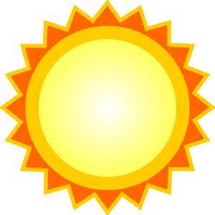
5th Grade Science Chp. 9
Weather

Slide 2
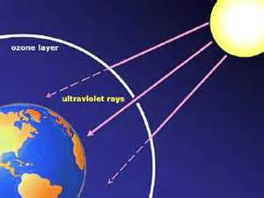
Words to Know
Troposphere –
The layer of the atmosphere closest to the earth’s surface.
Relative Humidity –
The amount of water vapor in the air compared with the total amount of water vapor that air can hold at that temperature.

Slide 3
Layers of Earth’s Atmosphere
Troposphere – 1st layer of atmosphere where all weather occurs.
Stratosphere – 2nd layer of atmosphere where the ozone layer and jet stream are located.
Mesosphere – 3rd layer of atmosphere where meteors burn up.
Thermosphere – 4th layer of atmosphere where the TV and radio signals occur from satellites.
Exosphere – 5th layer of atmosphere where space begins.

Slide 4
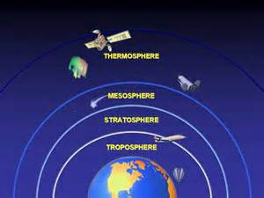
Layers of Earth’s Atmosphere

Slide 5
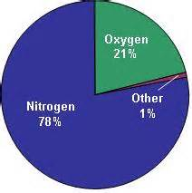
The Composition of the Atmosphere

Slide 6
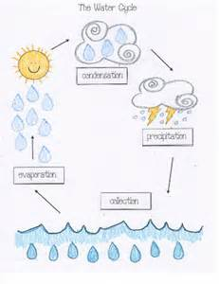
The Water Cycle

Slide 7
The Water Cycle
The Water in the Oceans evaporate,
Turn into water vapor and condensate,
When the clouds are full it precipitates,
And the cycle starts over again, mate.

Slide 8
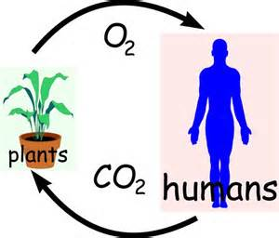
The Carbon Dioxide Cycle

Slide 9
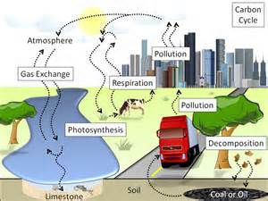
Global Warming

Slide 10
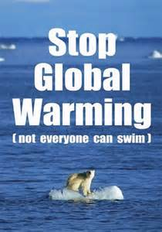
Global Warming
The production of excess Carbon Dioxide which causes the depletion of the ozone layer. When this happens more ultraviolet light reaches the Earth’s surface causing the atmosphere and water to increase in temperature.
Effects – Melting of Glaciers, Flooding, changes in climate and animal habitats, etc.

Slide 11
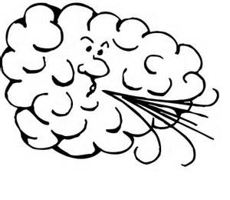
4 Conditions that make up weather
Air temperature
Air pressure
Wind
Water

Slide 12
What causes Air Pressure?

Slide 13
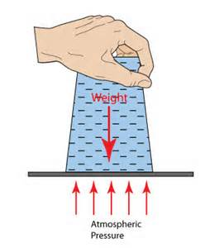
What causes air pressure?
Air pressure is caused by the weight of the air itself.

Slide 14
What causes wind?

Slide 15
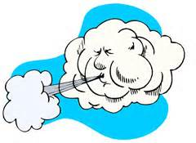
What causes wind?
Wind is caused by the difference in air pressure and air temperature.
Wind is also caused by the movement from regions of high pressure to low pressure.

Slide 16
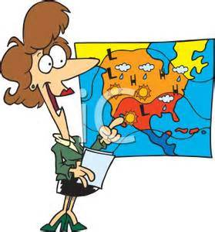
Rules of Weather
When warm air meets cold air, it’s the battle of the winds.
Warm air rises, cold air sinks.

Slide 17
Vocabulary – Lesson 2
Air Mass – a large body of air that has abut the same temperature and moisture throughout.
Front – the boundary or area of contact between two air masses.

Slide 18
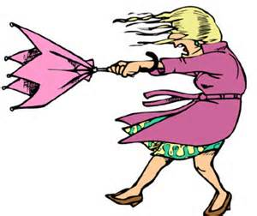
Three types of Fronts
Cold Front
Warm Front
Stationary Front

Slide 19
4 Types of Air Masses
Dry Polar – Fairbanks, Alaska
Moist Polar – Juneau, Alaska
Dry Tropical – Palm Springs, CA
Moist Tropical – Honolulu, Hawaii

Slide 20
Cold Fronts
Fronts form when one air mass takes over a slower air mass .
A cold front forms when a cold air mass overtakes a warm air mass.
Causes storms to form along the cold front
After the cold front passes weather becomes fair and cool sky clear with some clouds.

Slide 21
Warms Fronts
A warm front forms when a warm air mass overtakes a cold air mass.
The warm air slides over the denser cold air, cirrus clouds form.
Bring steady rains for several days.
After a warm front passes it brings warm and cloudy weather.

Slide 22
Lesson 3 – Storms
Storm – a weather disturbance caused by unusual weather conditions.
Thunderstorm – a small, local storm with tall clouds, heavy rain and thunder and lightning.
Hurricane – a large tropical storm with winds greater than 74 miles per hour and heavy rains.
Tornado – a small funnel of wind moving very quickly.

Slide 23
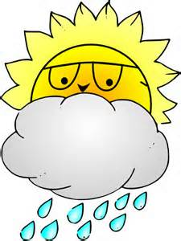
4 traits of Storms
Low pressure.
Clouds.
Some form of precipitation.
Strong Winds.

Slide 24
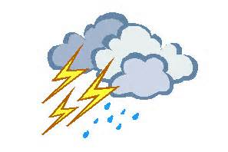
5 Characteristics of Thunderstorms
Tall clouds.
Heavy rains.
Thunder and lightning.
Form along cold fronts.
Small local storm.

Slide 25
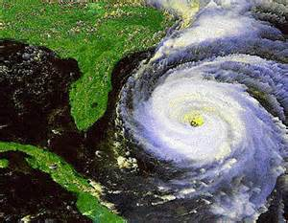
3 Traits of Hurricanes
Tropical storm.
High winds – greater than 70 mph.
Heavy rainfall – causes flooding.

Slide 26
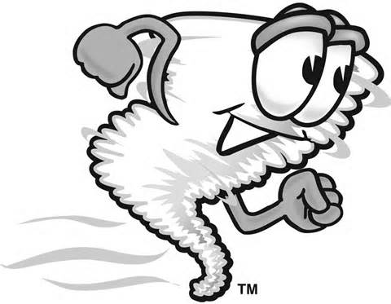
Tornadoes
Forms from thunderstorms.
Most dangerous type of storm.
Highest wind speed.
Funnel of quickly spinning air.

Slide 27
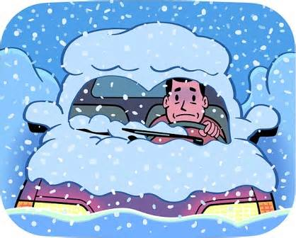
Blizzards
Drifting snow.
Poor visibility.
High wind.
Heavy snowfall.

Slide 28
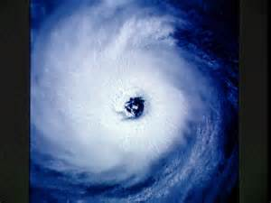
Eye of the Hurricane
Calm wind.
Fair skies.
Clear Weather.

Slide 29
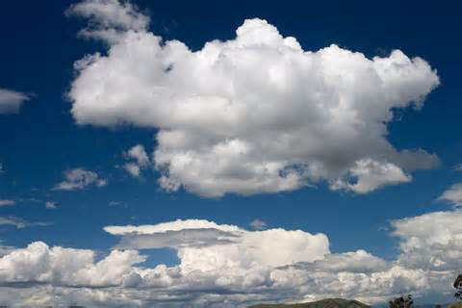
Clouds
Cumulus Clouds-
Large white puffy clouds that generally appear during fair weather.

Slide 30
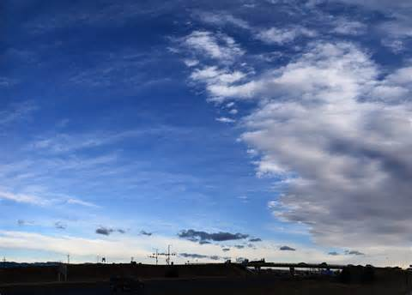
Clouds
Stratus Clouds –
Low flat clouds that stretch over the sky, creating overcast conditions.

Slide 31
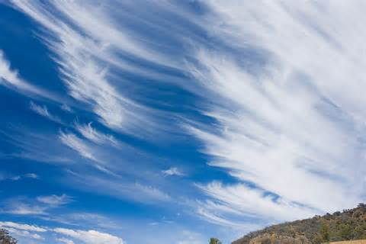
Clouds
Cirrus Clouds –
Lacy or wispy cloud that form at high altitudes, generally before a change in the weather.

