Slide 1
5th Grade Science Chapter 1
Lesson 3
Fungi

Slide 2
Copy following notes in copybook
**Four types of Fungi
1. Mushrooms – many celled
2. Mold – one celled
3. Yeast – one celled
4. Mildew – one celled

Slide 3
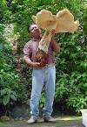
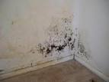
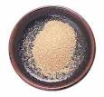
Mushrooms
Mold colony
Mildew
Yeast

Slide 4
Copy following notes
Fungi
1. One-celled or many celled
2. Do not contain chlorophyll
3. Plantlike
4. Do not make their own food
5. Some fungi are scavengers
6. Some fungi are parasites

Slide 5
Copy following notes
Mushrooms
1. Many celled
2. Reproduce by spores
3. Live either as scavengers or parasites
4. Some poisonous

Slide 6
Copy following notes
Mold
1. Grows on Bread or Fruit
2. Uses nutrients from what it grows on
3. Reproduce by spores
4. Single celled
5. Live in colonies (groups of mold)

Slide 7
Copy following notes
Yeast
1. Single celled
2. Forms and lives in colonies
3. Use Yeast to make bread, pizza dough, etc.
4. Yeast uses or eats sugar and forms Carbon Dioxide gas which makes the bread rise.

Slide 8
Copy following notes
Mildew
1. Single-celled
2. Grows on damp things
3. Can harm materials or leather
4. Mildew can cause damage to trees and other living things.

Slide 9
Copy the following notes
Helpful Uses of Fungi
1. Used for food – eg. Mushrooms and blue cheese
2. Used for medicine – Penicillin
3. Helps break down dead and decaying things.

Slide 10
Copy following notes
Harmful uses of Fungi
1. Some mushrooms are poisonous
2. Can cause damage to plants, cloth or leather (mildew and mold)
3. Cause disease (Athlete’s Foot)

Slide 11
Copy following notes
Sir Alexander Fleming – famous scientist whose discovery in 1928 led to the development of penicillin which is an antibiotic that has saved millions of people’s lives.
It is made from a type of mold.

Slide 12
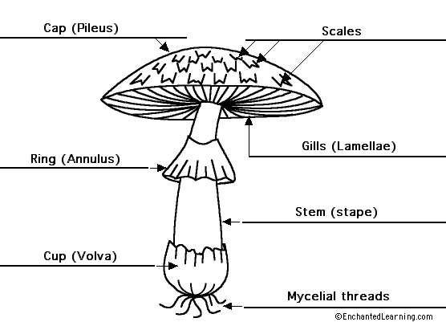
Draw in copybook -
Diagram of a Mushroom

