Slide 1
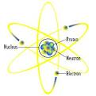
6th Grade Science Chapter 6
Atoms, Elements and Compounds

Slide 2
Chapter 6 – Atoms, Elements and Compounds
Matter – anything that takes up space and has mass. Matter is made up of atoms.
Model – a mental picture or figure.

Slide 3
Atoms have 3 parts.
Atom – basic unit of all non-living things.
Proton – a subatomic particle with a positive charge found in the nucleus of an atom.
Neutron – a subatomic particle with a neutral charge found in the nucleus.
Electron – a subatomic particle with a negative charge found in the nucleus.

Slide 4
Protons and Neutrons are found in the nucleus.
Bohr Model of an atom is also called the planetary model.
Bohr Model – an atomic model in which the electrons move around the nucleus in orbits. Developed by Neils Bohr, a Danish scientist.

Slide 5
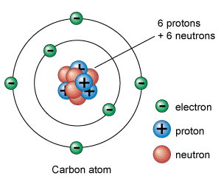
Bohr Model of an Atom

Slide 6
The number of Protons = to the number of
Electrons.
The positive charges of the Protons balance the negative charges of Electrons.
Therefore the whole atom is Neutral. An atom in a normal state is neutral.

Slide 7
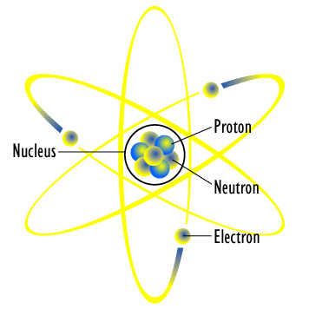
Electron Cloud Model – an atomic model in which the electrons move around the nucleus in all directions.

Slide 8
Elements – Made up of one kind of atom.
There are #109 + known elements.
Atomic Number = # of protons =
# of electrons.

Slide 9
Periodic Table – a table the contains information about the elements arranged in atomic number.

Slide 10
Information about the Elements
8 Atomic Number - # of protons
C _{Chemical Symbol}
Carbon
12.011 _{Atomic Mass – weight of atom}

Slide 11
Periodic Table
How are elements grouped?
Family – a group of elements found vertically (up and down) on the periodic table having similar characteristics.

Slide 12
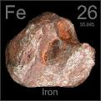
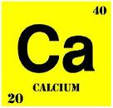
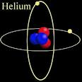
Elements

Slide 13
4 Groups of Elements
Metals – Shiny can be shaped, good conductors of heat and electricity.
Ex. – Iron (Fe)
Non-Metals- Dull, cannot be shaped, not conductors of heat and electricity.
Ex. – Hydrogen (H)
Semi-Metals – shares properties of both metal and non-metals.
Ex. – Silicon (Si)
Noble Gases – don’t combine easily with other elements.
Ex. – Helium (He)

Slide 14
Energy Level – the number of electrons in each level of an atom.
₉ ₂ Diagram of Flourine’s Energy Levels
F ₇
Flourine

Slide 15
Diagram of Sulfur’s Energy Levels
Level 1 - 2 electrons
Level 2 - 8 electrons
Level 3 - 6 electrons
₁₆ ₂
S ₈
Sulfur ₆

Slide 16
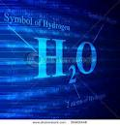
Compound – Substance formed when two or more elements combine chemically and form a new substance.
Chemical Bonds – forces that hold atoms together in a compound.

Slide 17
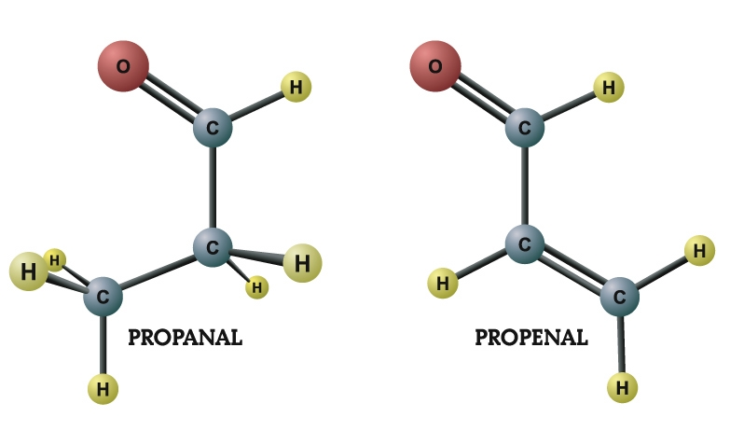
Molecules

Slide 18
Two kinds of chemical bonds:
Ions – atoms that have lost or gained an electron.
Example – NaCl - Sodium Chloride
common name Table Salt
Sodium (Na) loses an electron and becomes a sodium ion then Chlorine (Cl) gains that electrons and becomes a chloride ion.

Slide 19
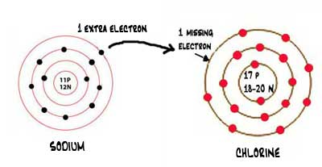
Ionic Bonds
Basically sodium and chlorine join because positive and negative charges attract.

Slide 20
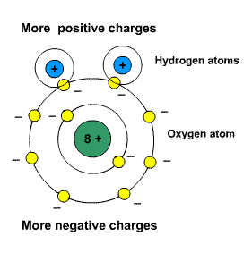
Chemical Bonds
Molecule – particle formed by sharing electrons. Ex. H₂0
Hydrogen and Oxygen share electron.

Slide 21
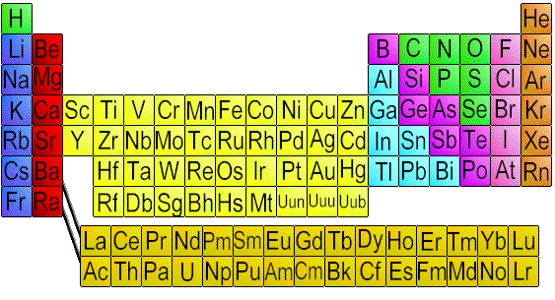
Chemical Formula – a group of symbols that represent the elements in a compound.
Ex. CO₂, CO, H₂0, NaCl
Chemical Symbol – a letter that stands fro the name of an element.

Slide 22
Hydrocarbons
H₂0, NH₃ What does the small number represent?
It represents the number of atoms in the elements it follows.
Example – H₂0 – 2 Hydrogen Atoms and
1 Oxygen Atom
Example – NH₃ – 1 Nitrogen and 3
Hydrogen Atoms

Slide 23
Organic Compounds
Organic Compounds – Compounds that contain carbon.
Organisms – any living thing.
Hydrocarbon – a compound made of carbon and hydrogen.
Example – CH₄ – Methane
Octane C₅H₁₅

Slide 24
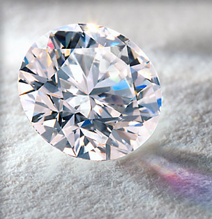
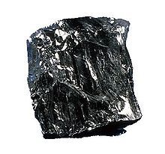
Forms of Carbon
Coal
The hardest, purest form of carbon – Diamond
Graphite

Slide 25
Polymers
Polymer – An organic compound made of a chain o carbon atoms.
Example: Fabrics, Plastics and Rubber
Each part of a polymer is called a monomer.

Slide 26
Uses of Polymers
Plastic materials – toys, hairbrushes, etc.
Fabrics – clothes, carpeting, material, etc.
Rubber products – tires, sneakers, etc.

Slide 27
Acids and Bases
There are two types of compounds:
acids and bases.
Indicator – a dye which changes color when mixed with an acid or a base.
Litmus paper is a type of indicator which can turn red or blue.

Slide 28
Acids and Bases
Acid – A compound which turns blue litmus red is an acid and a pH of 0-6.
Base – A compound which turns red litmus blue is a base and has a pH of 8-14.

Slide 29
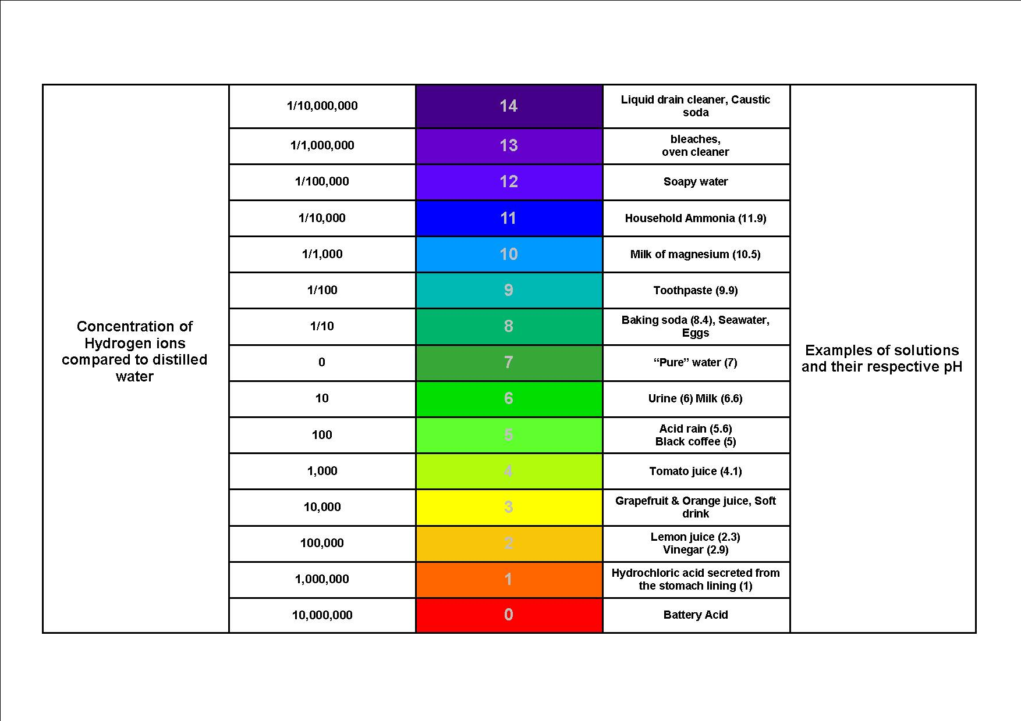
pH Scale

Slide 30
Know these compounds
H₂0 water
CO₂ Carbon Dioxide
NaCl Sodium Chloride
CO Carbon Monoxide
NH₃ Ammonia
SO₂ Sulfur Dioxide

Slide 31
Prefixes
Mono one
Di Two
Tri Three
Tetra Four

Slide 32
Acids – 2 types
Strong Acids – pH closer to 1 than 7 on the pH scale.
Example – lemon juice and Hydrochloric Acid
Weak Acids – pH closer to 7 than 1 on the pH scale
Example – Oranges and Mild

Slide 33
Bases – 2 Types
Strong Bases – pH closer to 14 than 7
Example – Ammonia
Weak Bases – pH closer to 7 than 14
Example -

Slide 34
pH Scale
C) Scientists us a scale called the pH scale to describe and measure the amount of acids or bases in a given material.
**An acid has a pH between 0 and 6. The lower the pH of an acid, the stronger it will be.
** A base has a pH between 8 and 14. The higher the pH number of a base the stronger it will be.
A pH of 7 is neutral which means it is neither an acid or a base.

Slide 35
Effects of Neutralization
Salts – formed when an acid is combined with a base.
Neutralization – a chemical change when acid is combined with a base neutralizing the acid and forming a salt and water.
Example – Upset stomach – excess Gastric Acid – take an antacid – Pepto-Bismol, Tums, etc.
The result of neutralization is water and a salt.

