Slide 1
Science Chapter 7
Changes in Matter

Slide 2
Chapter 7 - Matter
Phases of Matter
A. Solid – matter with definite shape and volume.
Molecules are tightly compacted – very little kinetic energy.

Slide 3
Liquid
Matter with no definite shape but definite volume.
Molecules are spread out.
More room for movement – more kinetic energy.

Slide 4
Gas
Matter with no definite shape or definite volume.
Molecules are very spread out.
Greatest energy – most room for movement.

Slide 5
Plasma
4th State of Matter.
Most common state of matter in the universe.
Found in stars and sun because of extreme temperatures.

Slide 6
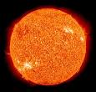
The Sun

Slide 7
Facts about the Sun (Read only – no notes)
The Sun is one out of billions of stars. The Sun is the closest star to Earth. The Sun rotates once every 27 days. The Sun is now a middle-aged star, meaning it is at about the middle of its life. The Sun formed over four and a half billion years ago. You may think the Sun will die soon, but it will keep shining for at least another five billion years. The Sun’s surface is called the photosphere. The temperature of the photosphere is about 10,000° Fahrenheit. Its core is under its atmosphere. The temperature at the core, or very middle, of the Sun, is about 27 million° Fahrenheit. That’s pretty hot!

Slide 8
The Sun continued
The Sun’s diameter is about 870,000 miles wide. The Sun is 109 times wider than Earth, and is 333,000 times heavier. That means if you put the Sun on a scale, you would need 333,000 objects that weigh as much as the Earth on the other side to make it balance.
The Sun is only one of over 100 billion stars. In ancient times, the people believed the Sun was a burning ball of fire created by the gods. Later, people thought it was a solid object, or a liquid ball. Over one million Earths could fit inside the Sun. Looking directly at the Sun can permanently damage your eyes because it is so bright. A star mostly gives off light and heat. The larger the star, the hotter its temperature. A supergiant star can get to be 400 times larger than our Sun, which is almost a million miles in diameter. The Sun is tilted.
Without the Sun, Earth could not support life. The Sun gives off heat and light that the Earth needs to support life (us). If you lived on the Sun, and you built a spacecraft, it would have to go over 618.2 kilometers per second to escape the Sun’s gravitational pull. The Sun is 695,000 kilometers at its equator. The Sun is the largest mass in our Solar System.

Slide 9
The Stars

Slide 10
Star Facts (read only)
All stars begin from clouds of cold molecular hydrogen that gravitationally collapse. As they cloud collapses, it fragments into many pieces that will go on to form individual stars. The material collects into a ball that continues to collapse under its own gravity until it can ignite nuclear fusion at its core. This initial gas was formed during the Big Bang, and is always about 74% hydrogen and 25% helium. Over time, stars convert some of their hydrogen into helium. That’s why our Sun’s ratio is more like 70% hydrogen and 29% helium. But all stars start out with 3/4 hydrogen and 1/4 helium, with other trace elements.

Slide 11
There are 2 types of chemical reactions:
Composition or synthesis – (coming together)
2 Elements combine to form a compound
Ex: H₂ ₊ O H₂O
The arrow means forms

Slide 12
There are 2 types of chemical reactions:
Decomposition – (breaking apart)
Compound breaks down into elements.
Ex: H₂0 H + H + O

Slide 13
Law of Conservation of Mass or Matter
Matter is neither created or destroyed through any chemical reaction.
Ex: H + H + O H₂0
There are 3 atoms on one side of the equation and 3 atoms on the other (count them)
Ex: H₂0 H + H + O
There are still 3 atoms on one side of the equation and 3 atoms on the other (count them)

Slide 14
Mass
A measure of the amount of matter in a substance or object.

Slide 15
Some Factoids on Mass (Read only)
Mass and Weight
The mass of an object is a fundamental property of the object; a numerical measure of its inertia; a fundamental measure of the amount of matter in the object. Definitions of mass often seem circular because it is such a fundamental quantity that it is hard to define in terms of something else.
The weight of an object is the force of gravity on the object and may be defined as the mass times the acceleration of gravity, w = mg. Since the weight is a force, its SI unit is the newton. Density is mass/volume.

Slide 16
Oxidation
A chemical change in which oxygen reacts with a substance.
There are two kinds of oxidation.
These are rapid and slow.

Slide 17
Corrosion (slow oxidation) -
A chemical reaction in which metal reacts with oxygen.
EX: Rusting – The rust formed is a new substance when the metal reacts with oxygen and water.
Bikes left out in the rain and snow will rust over time where the metal is exposed. The oxygen reacts with the metal.
At the seashore, metal objects will rust faster because of the amount of salt present in the atmosphere. Salt speeds up the process of oxidation.

Slide 18
Another form of slow oxidation
Rotting fruit is an example of slow oxidation.
The substances in the fruit combine with oxygen over time and begins the rotting process.
EX: Apples or Bananas exposed to oxygen over time start to turn brown and will continue to oxidize or break down (rotting).

Slide 19
Rapid Oxidation
Form of oxidation that occurs quickly.
Ex: Burning, fireworks, etc.
Rapid oxidation can be dangerous.
Ex: Explosions
Explosions occur because of flammable substances coming into contact with heat and oxygen.

Slide 20
Dangers of rapid oxidation
At the gas pumps never smoke.
Heat could cause the gasoline vapors to ignite when oxygen is present and cause a fire and an explosion.
This is an example of a dangerous rapid oxidation.

Slide 21
Synfuel
Synthetic or manmade fuel put together by other substances.
EX: Methane (CH4) or Gasahol.
Additional Information
Manmade fuels conserve resources.
Gasoline is a carbon compound and is not a renewable resource.
It is found on the surface of the earth in some areas like Texas and Alaska or in the Ocean as in the waters off of England or in the Gulf Coast.
One day the planet will run out of gasoline.
Alternate fuels are becoming more and more important.

Slide 22
Lesson 3 – Changes in the Nucleus
Nuclear Reaction –
A reaction where the nuclei or nucleus of an atom is changed releasing tremendous amounts of energy.

Slide 24
Radioactive Elements –
Elements whose nuclei naturally break down. Very active.
EX: Radium, Plutonium, Uranium
Atomic Number greater than 86

Slide 25
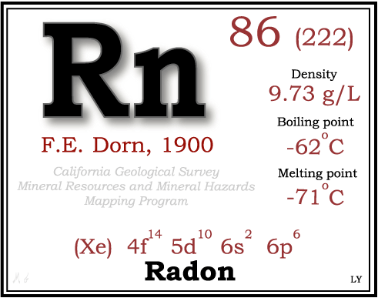
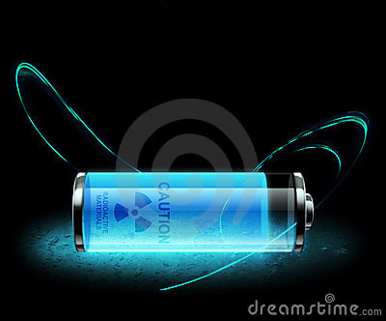

Slide 26
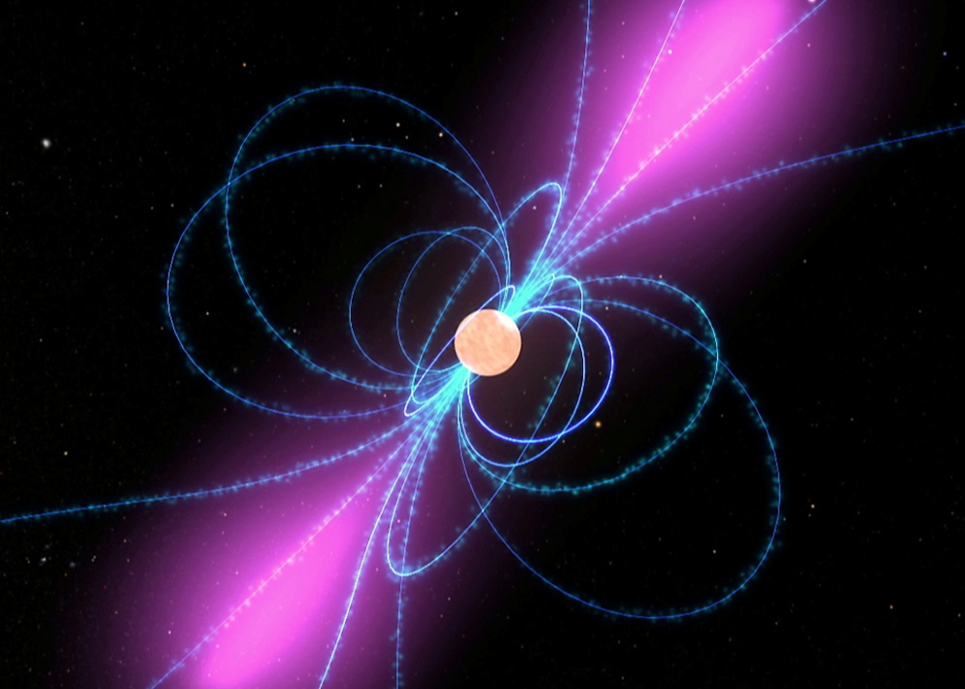
Gamma Rays –
Form of energy that you cannot see or fee, but can pass through many materials.

Slide 27
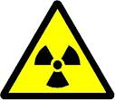
Radiation –
Harmful particles of gamma rays given off by radioactive elements.

Slide 28
Nuclear Fission – “Splitting Apart” -
Type of nuclear reaction in which large nuclei of uranium is split apart to generate large amounts of energy.
Uses radioactive elements as its fuel.

Slide 29
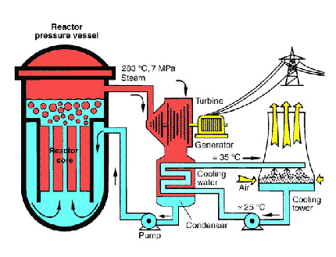

Slide 30
Nuclear Reactor –
Device which controls a nuclear reaction.
Parts of a Nuclear Reactor
Core – Controls the fuel (Uranium)
Control Rods – Controls the speed of reaction.
Liquid – Carries away heat (coolant – cools down reaction)
Shielding – Stops radiation from getting out.

Slide 31
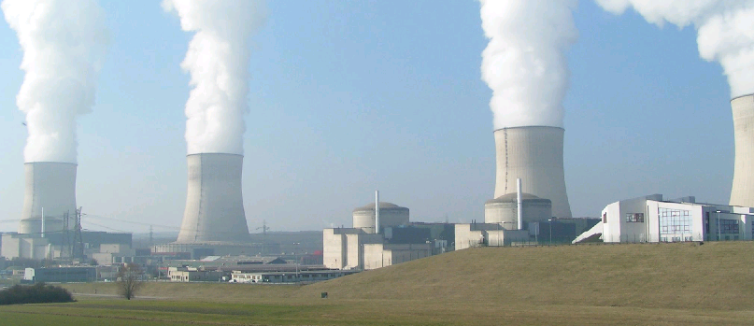
Nuclear Power Plant –
Uses heat released in a nuclear reaction in the form of steam to create electricity.

Slide 32
Advantages of a Nuclear Power Plant
Conserves fossil fuels (coal,oil)
Doesn’t create pollution
After built, does not cost a lot to run in comparison

Slide 33
Disadvantages of Nuclear Power Plant
Give off radiation because uses radioactive elements.
Radioactive wastes are produced which are dangerous to living organisms.

Slide 34
How other products of reactors are used:
Used in cancer treatment
Used in cancer research
Used for diagnosis of cancer

Slide 35
Another type of Nuclear Reaction
Nuclear Fusion –
a change in which small nuclei (hydrogen) come together to form a larger helium nucleus.
Fusion begins with the smallest of all atoms hydrogen (Atomic Number = 1) 1 Electron, 1 Proton, 1 Neutron
Happens naturally on the surface of the sun and stars.
Gives off tremendous amounts of energy in the form of heat and light.

Slide 36
Advantages of Fusion
Fuel source (H) is easily found and inexpensive.
No radiation and no pollution.
Produces more energy than fission or chemical reactions.
Conserves fossil fuels.

Slide 37
Disadvantages of Fusion
Extreme temperatures are needed to create a fusion reaction.
Needs large amounts of energy to reach temperature for fusion to occur.

Slide 38
Describe a fusion reaction that happens on the Sun:
Hydrogen + Hydrogen Helium
Hydrogen nuclei come together to form a larger helium nucleus releasing tremendous amounts of energy in the process.

Slide 39
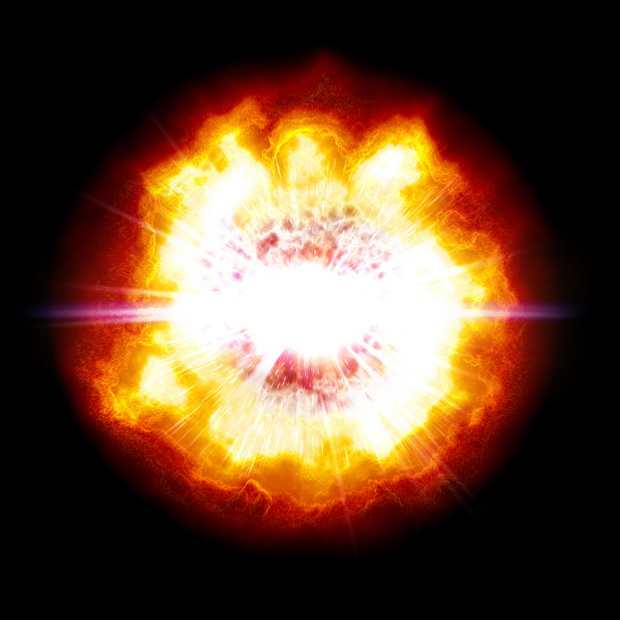
Fusion captured as it occurs on the surface of the sun

Slide 40
Fusion Energy: The Truth
Nuclear fusion energy remains vague or unknown to the general public for many years. Despite being the possible solution to mankind’s energy crisis via a fairly safe and waste-free electricity generation process, its research appears to be never-ending and a few witnesses predict that it will take another 20 years for the technology to be commercially available. Well, the same has happened for the past 50 years.
Still, the potential nuclear fusion power seems to guarantee has drawn numerous personnel and corporations to find ways to manipulate its commercial prospects. Can fusion energy live up to its promises?

Slide 41
The Potential of Fusion Energy
It is an undeniable fact that nuclear fusion is a notably promising source for future commercial energy. Since the 1950s, scientists have been trying to sustain fusion reactions to produce energy. The development of fusion power has come a long way and has been greatly improved, but the majority of scientists believe that commercial fusion energy is still a few decades away.
In an attempt to speed up the estimated time to complete this research, the International Thermonuclear Experimental Reactor (ITER) was launched. ITER is a project functioning under a joint partnership between the European Union, Japan, China, India, Korea, Russia and the U.S. to research and develop the scientific and technical potential of fusion energy. It aims to prove that large-scale fusion reactions are possible, and that it can be sustained with the concept of “tokamak”. Other than ITER, various reactor designs exist to fuel similar scientific experiments such as NIF and the Sustained Spheromak Physics Experiment.

Slide 42
If fusion energy is successfully produced on a commercial scale, the promises it upholds look rather unbelievable. Tritium is used in nuclear fusion. Regardless of its rarity in nature, it can be mass-produced in nuclear reactors by enclosing the plasma in a breeder blanket of lithium or other chemical elements to trigger neutron reactions. Upon its creation, tritium will be extracted and reprocessed as nuclear fusion fuel. Actually, the production of tritium exceeds the utilization, hence providing sufficient energy source for the reactor. Helium, an inactive and nontoxic chemical, is the waste product of nuclear fusion.
Theoretically, fusion energy does not post radiation threat, as the plasma will immediately vanish if the reaction process has gone awry, thus preventing nuclear leaks. Fusion energy seems to be the perfect energy source – uncontaminated, recyclable, self-sustaining and somewhat, rather safe. Yet, a great deal of hard work has been dedicated to its slightest development.

